Slide 1





DBS project 1 Report
Personal_Info_System
22CST Yusi (蒋云翔)
Monday, December 9, 2024

Slide 2



TABLE OF CONTENTS
01
02
04
03
Project’s object
JDBC Brief Intro
JavaFX Brief Intro
05
Project Development Environment
Project Introduction
06
07
File structure
Usage Guide

Slide 3



01
Project’s object

Slide 4

Project’s object
Craft a Java application that utilizes JDBC to establish a connection with a live database. The application should be capable of handling both data and metadata operations, functioning as a straightforward database management utility for database administrators. It should be able to accept SQL commands and present the outcomes in a well-organized textual format.

Slide 5
02
JDBC Brief Intro

Slide 6
JDBC Brief Intro
JDBC API serves as a Java-based architecture that enables communication with various types of structured data, predominantly in relational databases. It addresses three key programming functions within Java applications. Comprising four essential elements: the JDBC API, which allows Java applications to engage with relational data; the JDBC Driver Manager, that facilitates connections between Java applications and JDBC drivers; the JDBC Test Suite, which aids in confirming the compatibility of JDBC drivers with certain programs; and the JDBC-ODBC Bridge, enabling JDBC connectivity via ODBC drivers. The process of utilizing JDBC in programming encompasses several stages: initiating a connection to a database or other data sources, dispatching queries and updates, and subsequently retrieving and managing the database's reactions to these requests.

Slide 7
03
JavaFX Brief Intro

Slide 8
JavaFX Brief Intro
JavaFX is a Java-based framework designed for creating and delivering dynamic user interfaces, particularly for desktop applications and recently expanded to mobile and embedded systems. It encompasses a comprehensive set of tools for building rich internet applications (RIAs) that can run across a variety of platforms. JavaFX addresses the need for modern UI development with three primary components: the JavaFX SDK, which provides a rich set of UI controls and tools for developers; the JavaFX Runtime, which enables the execution of JavaFX applications; and the JavaFX Scene Graph, which facilitates the rendering of complex UIs with animations and graphics. The process of developing with JavaFX involves several stages: designing the user interface using JavaFX's extensive library of UI components, coding the application logic, and then deploying the application across different platforms.

Slide 9
04
Project Introduction

Slide 10
Project Introduction
The Personal Information Management System is a simple yet efficient database application developed to manage personal information such as names, ages, genders, and addresses. Built using Java, JDBC, and JavaFX, this system provides a user-friendly interface for adding, viewing, updating, and deleting personal data records in a MySQL database.

Slide 11
Some Key Features of the Project
The system supports full CRUD (Create, Read, Update, Delete) functionalities:
Error Handling and Data Integrity
User-Friendly Interface
CRUD Operations
The system uses JavaFX to create an intuitive and easy-to-navigate graphical user interface (GUI), allowing users to interact with the database through simple form inputs and buttons.
The system ensures robust error handling to manage database exceptions and maintain data integrity during transactions.

Slide 12
05
Project Development Environment

Slide 13
Development Environment
JDK: Oracle JDK, Version 17.0.10
Database: MySQL, Version 8.0.40
JDBC Driver: Version 8.0.25
IDE: IntelliJ IDEA Community Edition 2023.3.5
Operating System: Windows 11

Slide 14
06
File structure

Slide 15
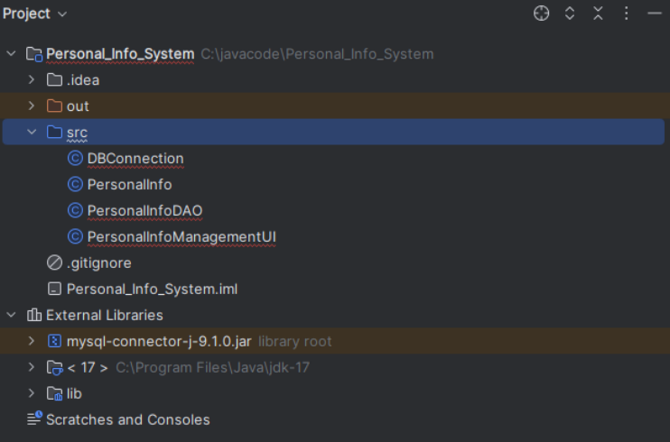
File structure

Slide 16
07
Usage Guide

Slide 17
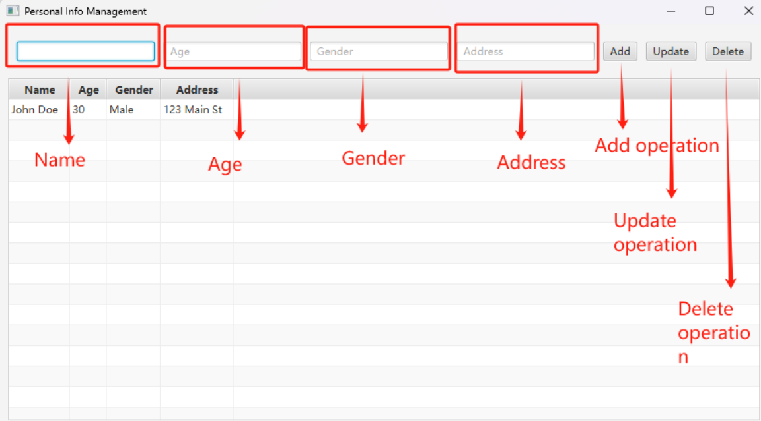
Usage Guide
When the core java program is loaded, it will connect directly to our local MySQL database, which can be directly added, deleted, changed and checked (Tips: we have pre-placed the username and password in other files to connect to the database).

Slide 18
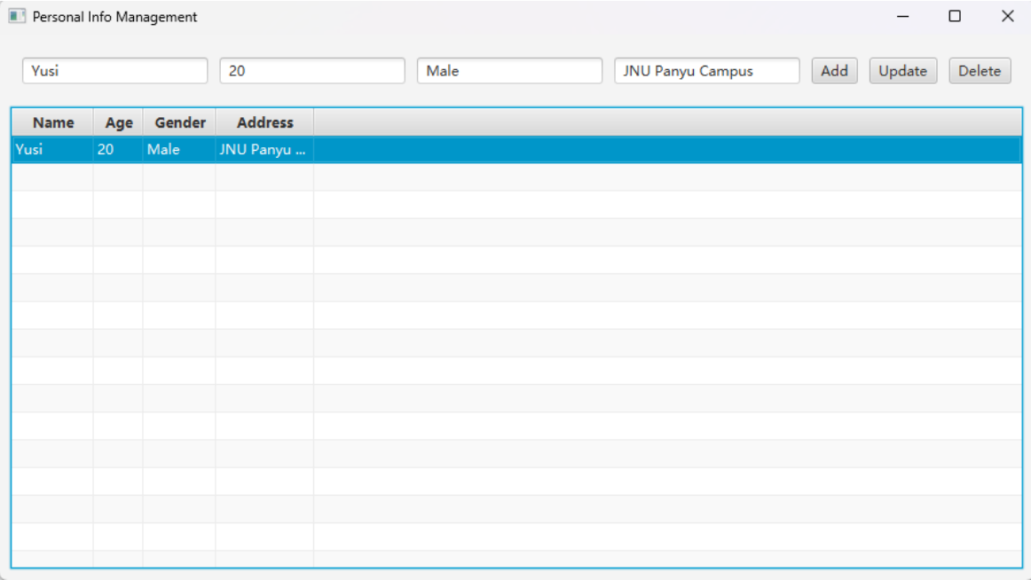
Usage Guide
Add operation

Slide 19
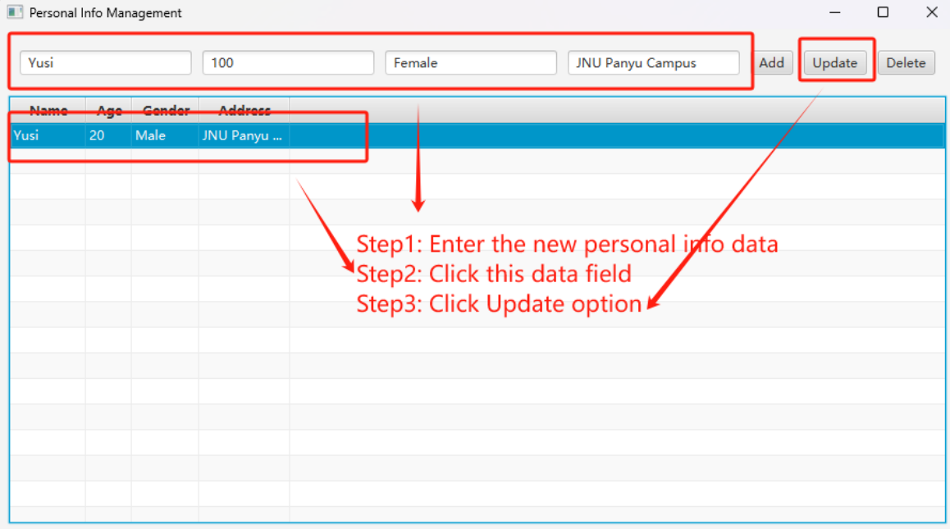
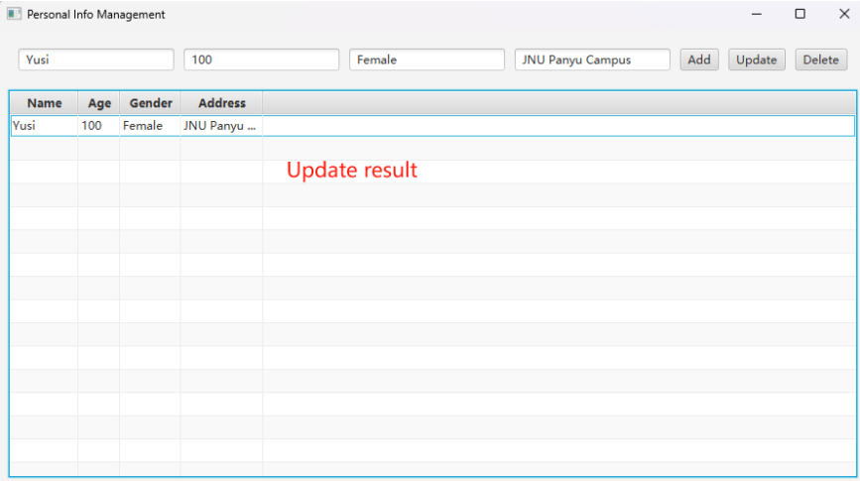
Usage Guide
Update operation

Slide 20
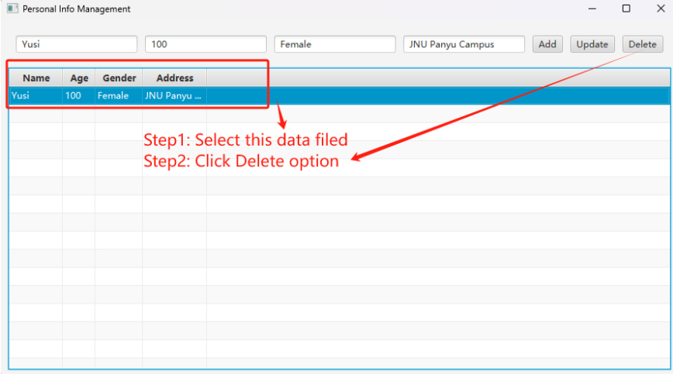
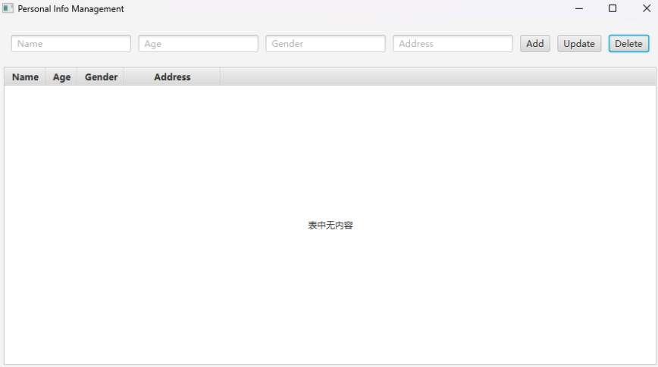
Usage Guide
Delete operation

Slide 21


THANKS!
Please keep this slide for attribution

